Slide 1
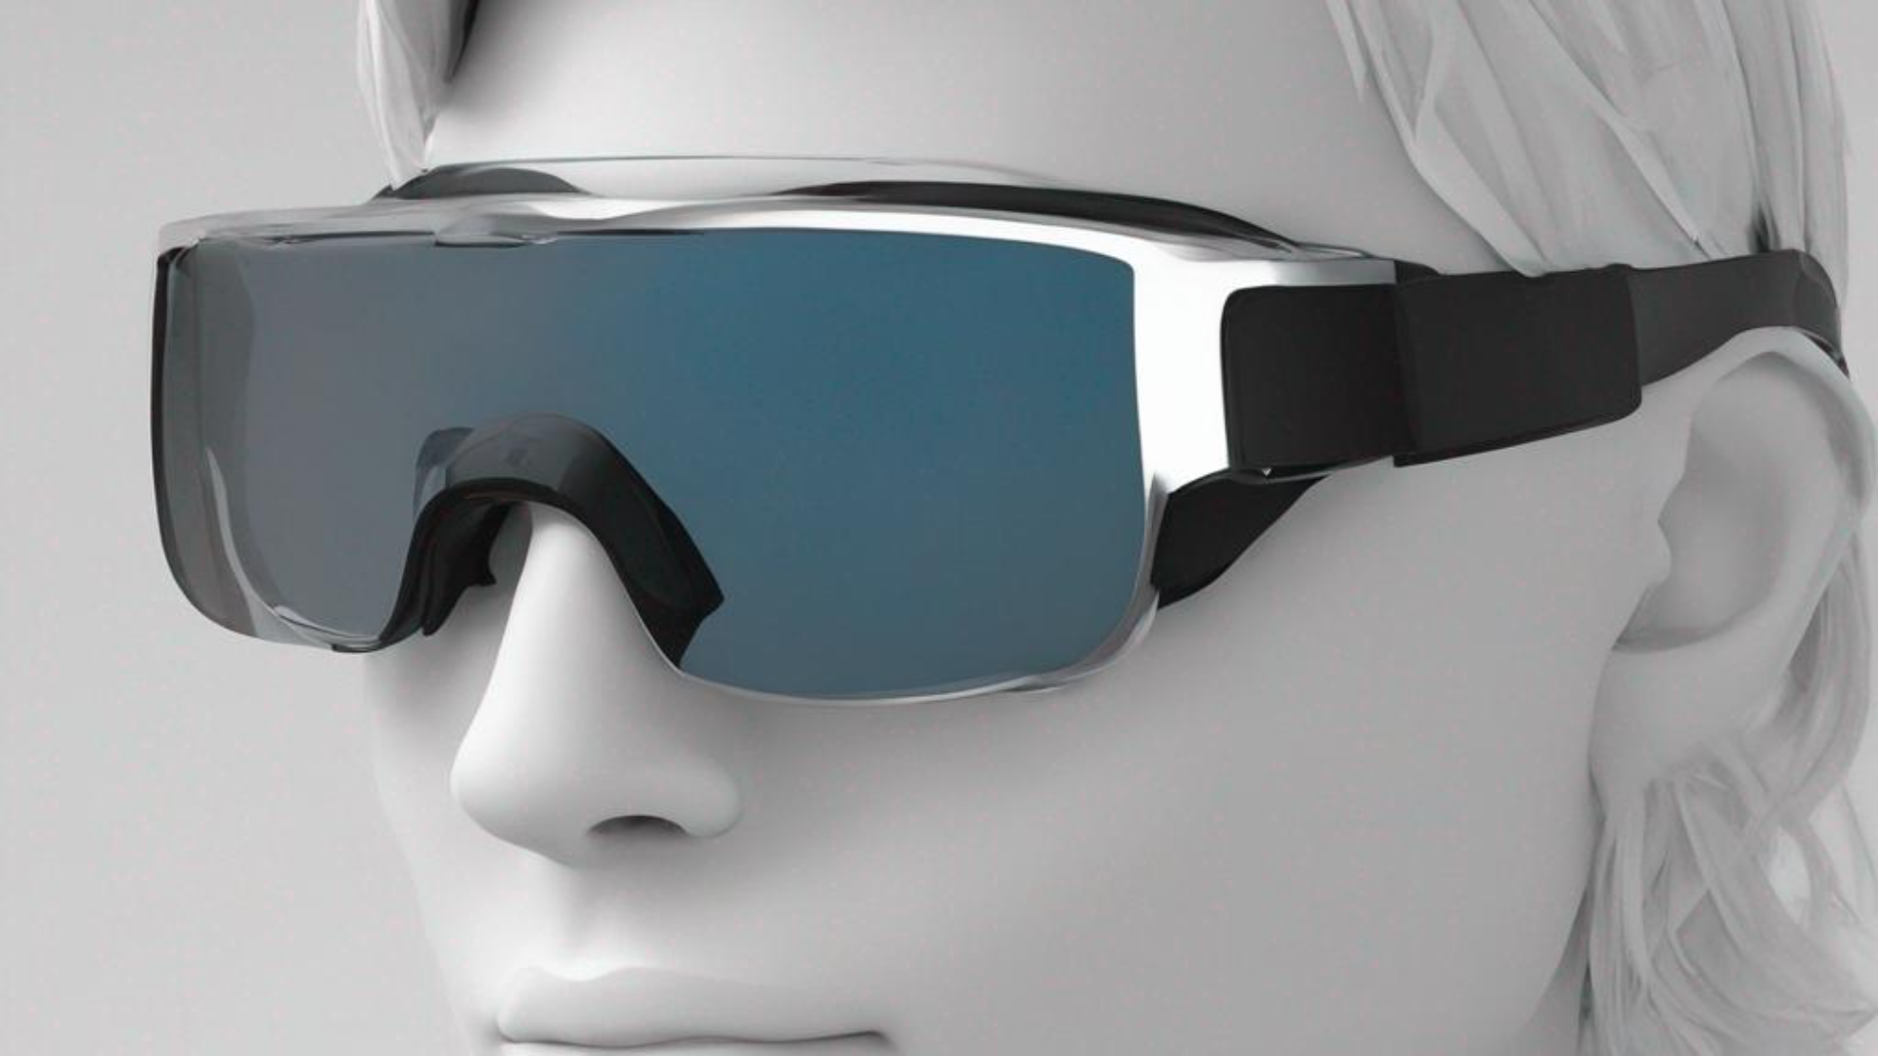
IOT PROJECT
SMART GLASS FOR VISUALLY CHALLENGED PEOPLE

Slide 2
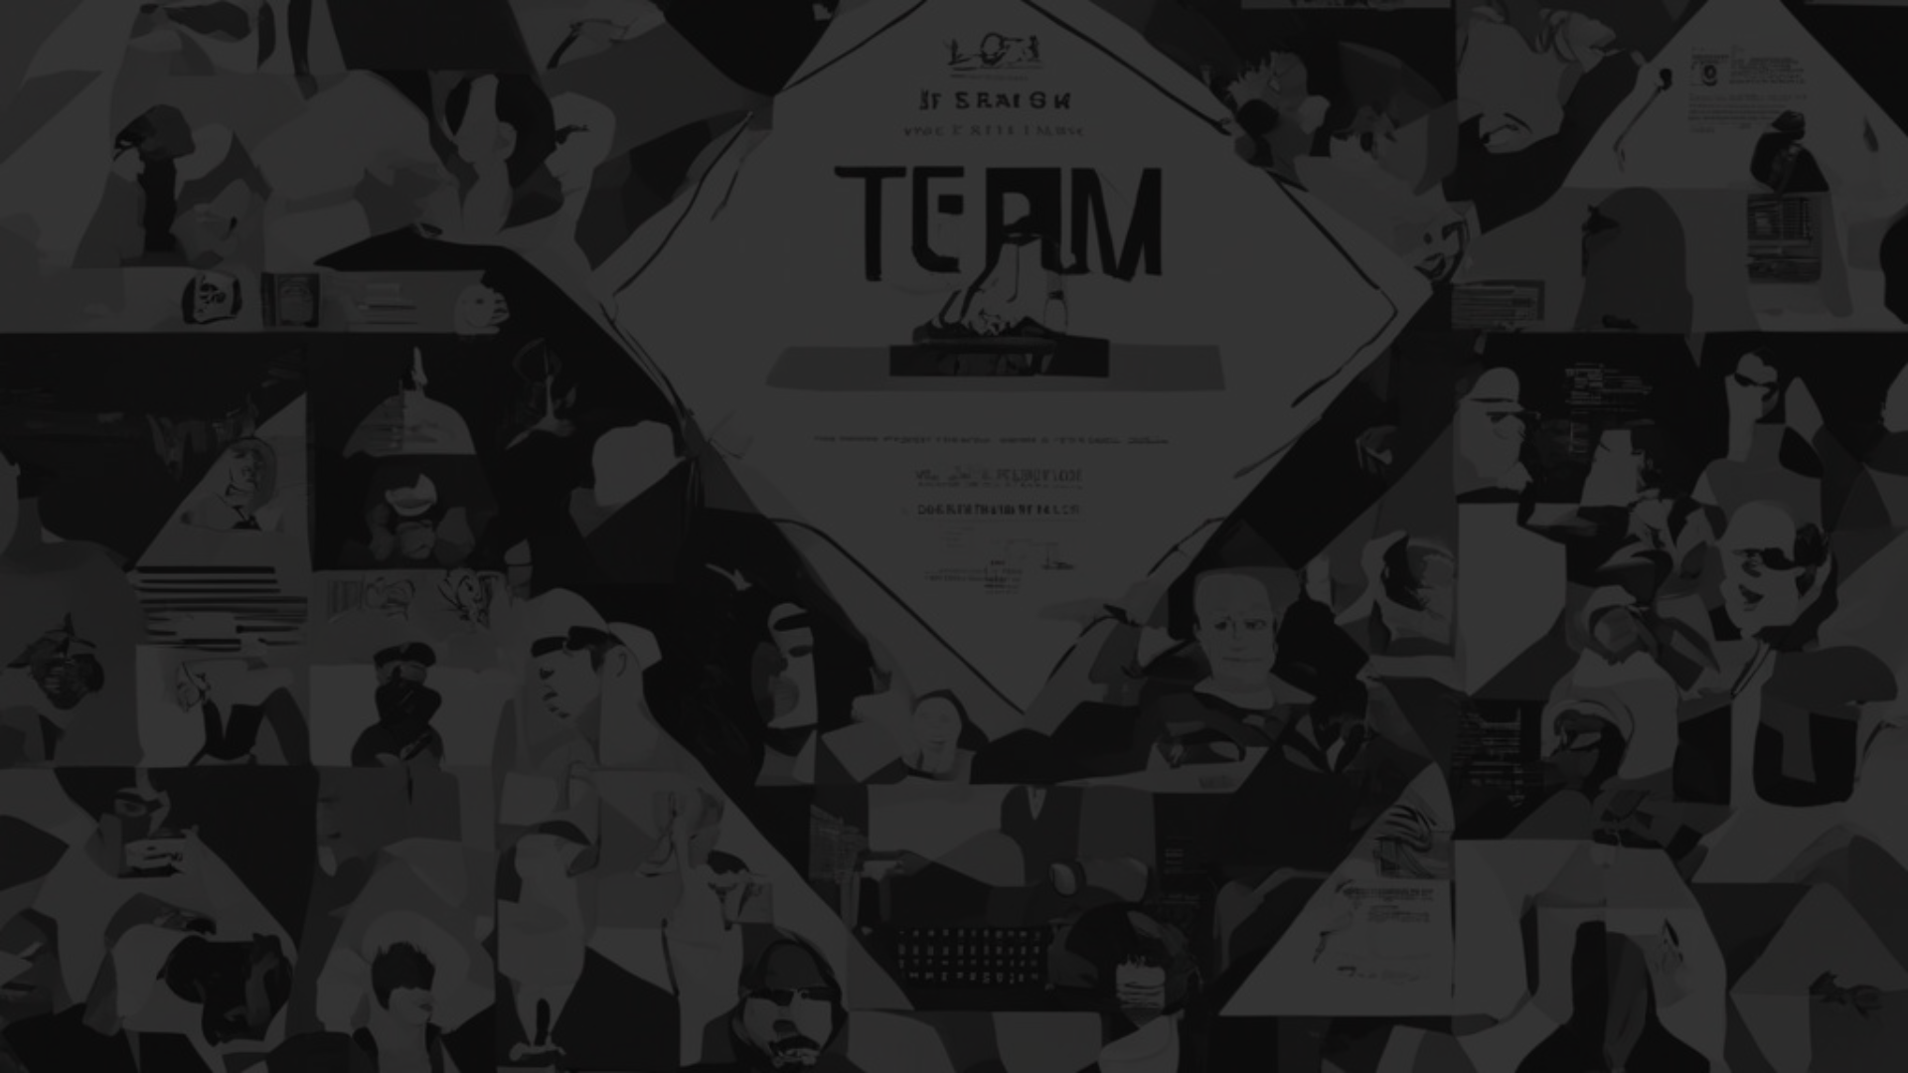
TEAM MEMBERS:
ASHWANTHRAM A C - CB.EN.U4CCE21009
GAUTAM R S - CB.EN.U4CCE21020
DEENA DAYALAN S - CB.EN.U4CCE21013
AKAASH ABHIMANYU B - CB.EN.U4CCE21004

Slide 3
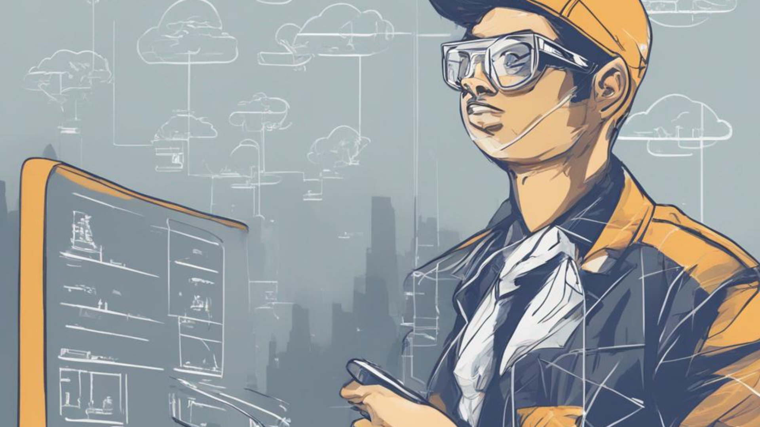
ABSTRACT:
Introducing Facial Recognition Smart Glasses for the visually challenged—a cutting-edge solution blending advanced facial recognition technology with real-time audio feedback. These glasses empower users by providing instant, discreet verbal descriptions of individuals in their vicinity, fostering independence and social inclusivity. With a user-friendly interface, stylish design, and cloud connectivity, this innovation marks a significant leap towards enhancing accessibility and autonomy for the visually impaired.

Slide 4

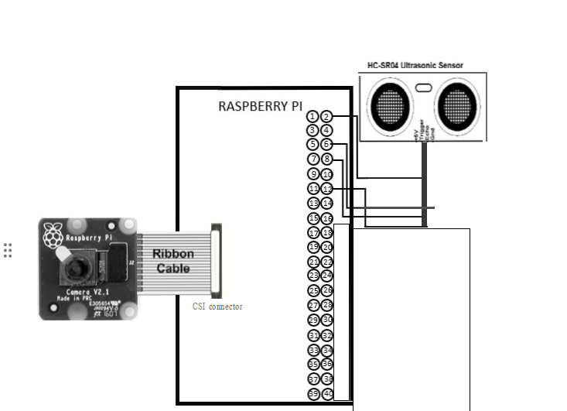
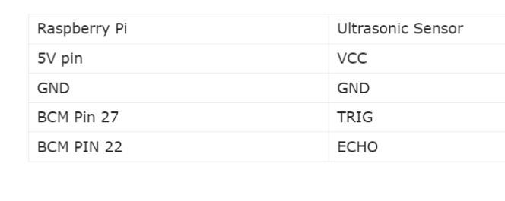
CIRCUIT DIAGRAM:

Slide 5

WORKING PRINCIPLE:
The Facial Recognition Smart Glasses operate by capturing facial features through a discreet camera, utilizing advanced algorithms to identify individuals from a pre-loaded database.
Upon recognition, real-time audio feedback delivers concise verbal descriptions to the user.
The device, with a user-friendly interface and stylish design, aims to enhance accessibility and independence for visually challenged individuals by fostering immediate and discreet communication in social interactions. Cloud connectivity ensures continuous updates to the recognition database, improving accuracy over time.

Slide 6
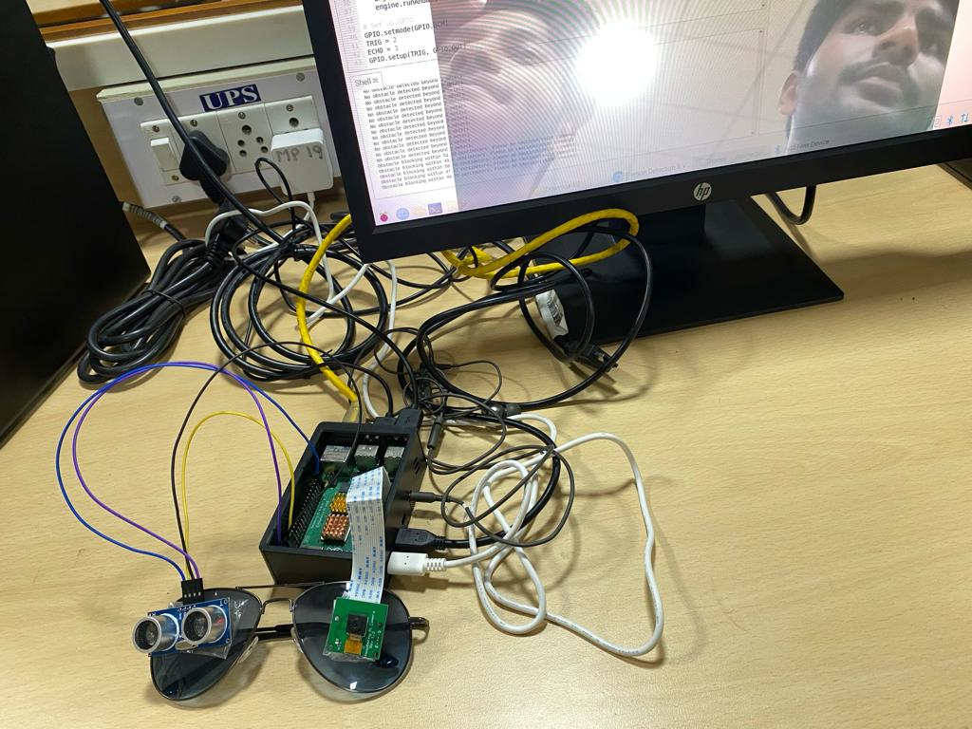
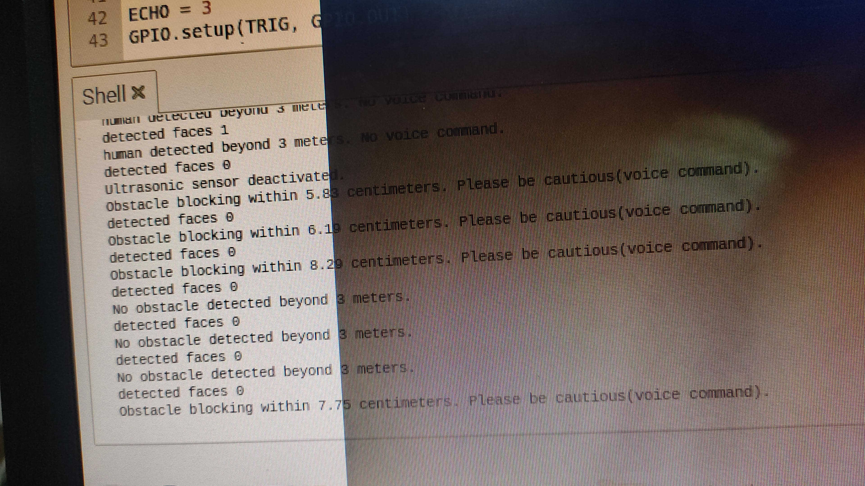
OUTPUTS:

Slide 7


